Slide 1


Bapuji Institute of Engineering and Technology, Davanagere- 577004
Department of Computer Science and Engineering,
Technical Seminar Presentation (21CS81)
on
PROMPT ENGINEERING IN HEALTHCARE
Presented by:
Anushree B Kuppast 4BD21CS020
Seminar guide
Prof. Raghu B R
Assistant Professor
Dept. of CS&E
Seminar Co-ordinators:
Prof. Rahima B Prof.Madhu N Hiremath
Assistant Professor Assistant Professor
Dept. of CS&E Dept. of CS&E

Slide 2

CONTENTS
1.Introduction
2.Evolution of AI in Healthcare
3. Objectives
4. Methodology
5. Snapshots
6. Advantages, disadvantages
7. Applications
8. Conclusion

Slide 3
Prompt engineering is a technique used in artificial intelligence (AI) to design effective prompts that guide language models to generate accurate and meaningful responses. In healthcare, it helps doctors and medical systems use AI for diagnosing diseases, suggesting treatments, and analyzing medical records. This makes healthcare faster, reduces mistakes, and helps doctors provide better care. It improves how AI interacts with medical professionals, making responses more accurate and helpful. This technology is transforming healthcare by making AI smarter and more reliable.
1.Introduction

Slide 4
2.Evolution of AI in Healthcare:
Basic Queries (Pre-2010) – Early AI models relied on simple, rule-based prompts with limited medical understanding.
Context-Aware Prompts (2010-2015) – NLP advancements enabled AI to understand medical context and refine responses.
LLM-Based Prompt Engineering (2015-2020) – Large Language Models (LLMs) like GPT improved accuracy in medical diagnosis and research.
Optimized Prompt Techniques (2020-Present) – Advanced prompting strategies (zero-shot, few-shot learning) enhance AI reliability in healthcare applications.
Future Trends – AI-driven prompt engineering will improve personalized healthcare, automated decision support, and real-time clinical assistance.

Slide 5
.
3.Ojectives:
.
To Enhance Medical Decision-Making – Assist doctors with accurate AI-driven insights for diagnosis and treatment.
To Improve Patient Interaction – Enable AI chatbots and virtual assistants to provide reliable health advice.
To streamline medical record analysis-- by helping AI extract relevant information efficiently.

Slide 6
4. Methodology
Data Collection & Processing:
Model Architecture:
Medical information is collected from reliable sources like health records and symptom databases. It is then cleaned, made anonymous, and processed using AI to find important details while following safety rules.
Transformer-based Model: Utilizes a Google FLAN-T5-Small model for medical text generation.
Hugging Face Pipeline: Streamlines model implementation for text-to-text generation.
PyTorch & Streamlit: Frameworks for AI model execution, PyTorch helps with AI model execution, while Streamlit makes interactive web apps simple to create.

Slide 7
Workflow:
User Input:Users enter symptoms as text through a simple UI (Streamlit-based).
Preprocessing:Transforms input symptoms into clear and relevant prompts for accurate AI processing.
Query Processing:The AI model (FLAN-T5-Small) generates medical responses using prompt engineering techniques for accuracy.
AI Response Generation:The model predicts possible illnesses based on symptoms, ensuring clear and relevant output.
User Interaction & Feedback:Users receive AI-generated medical suggestions and can refine inputs for better results.

Slide 8
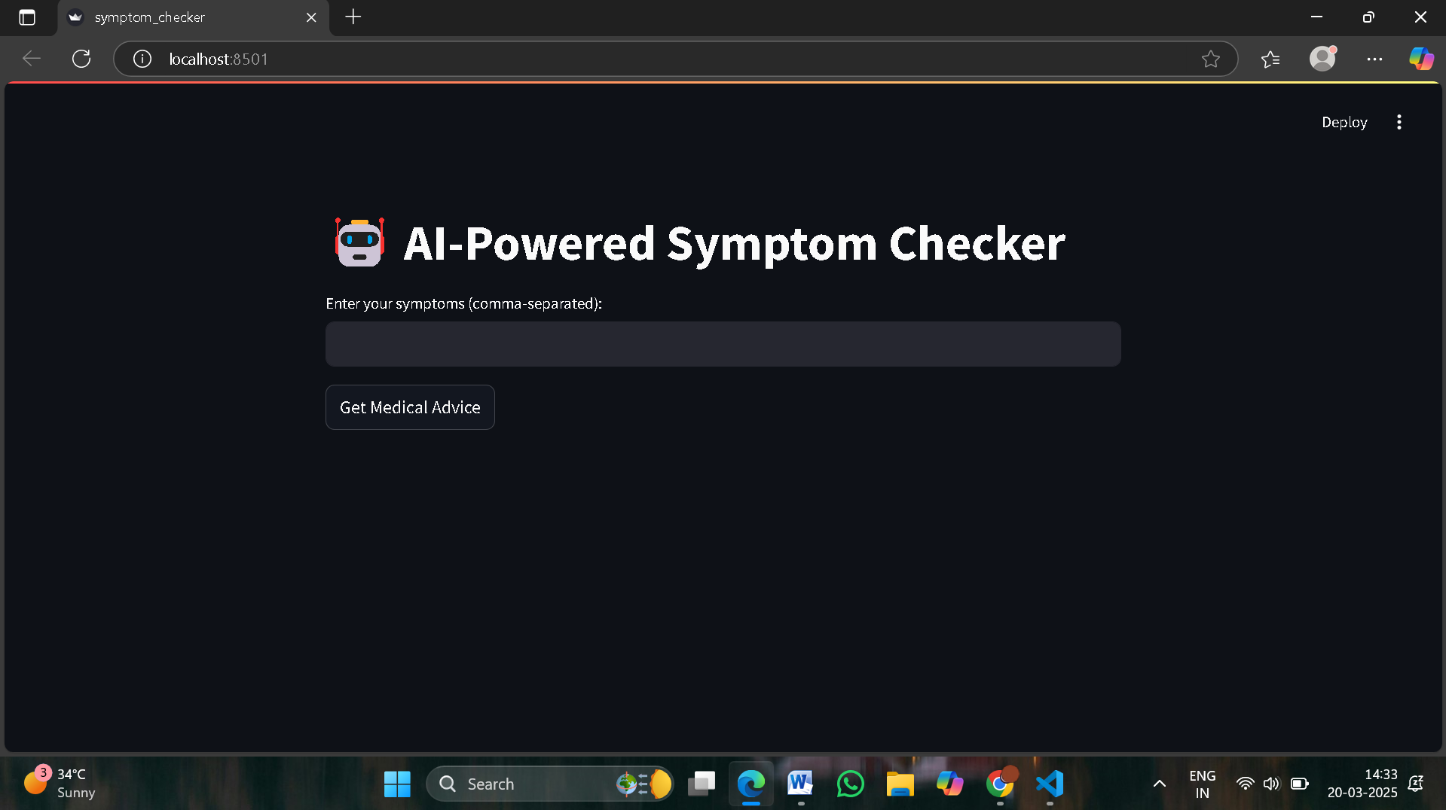
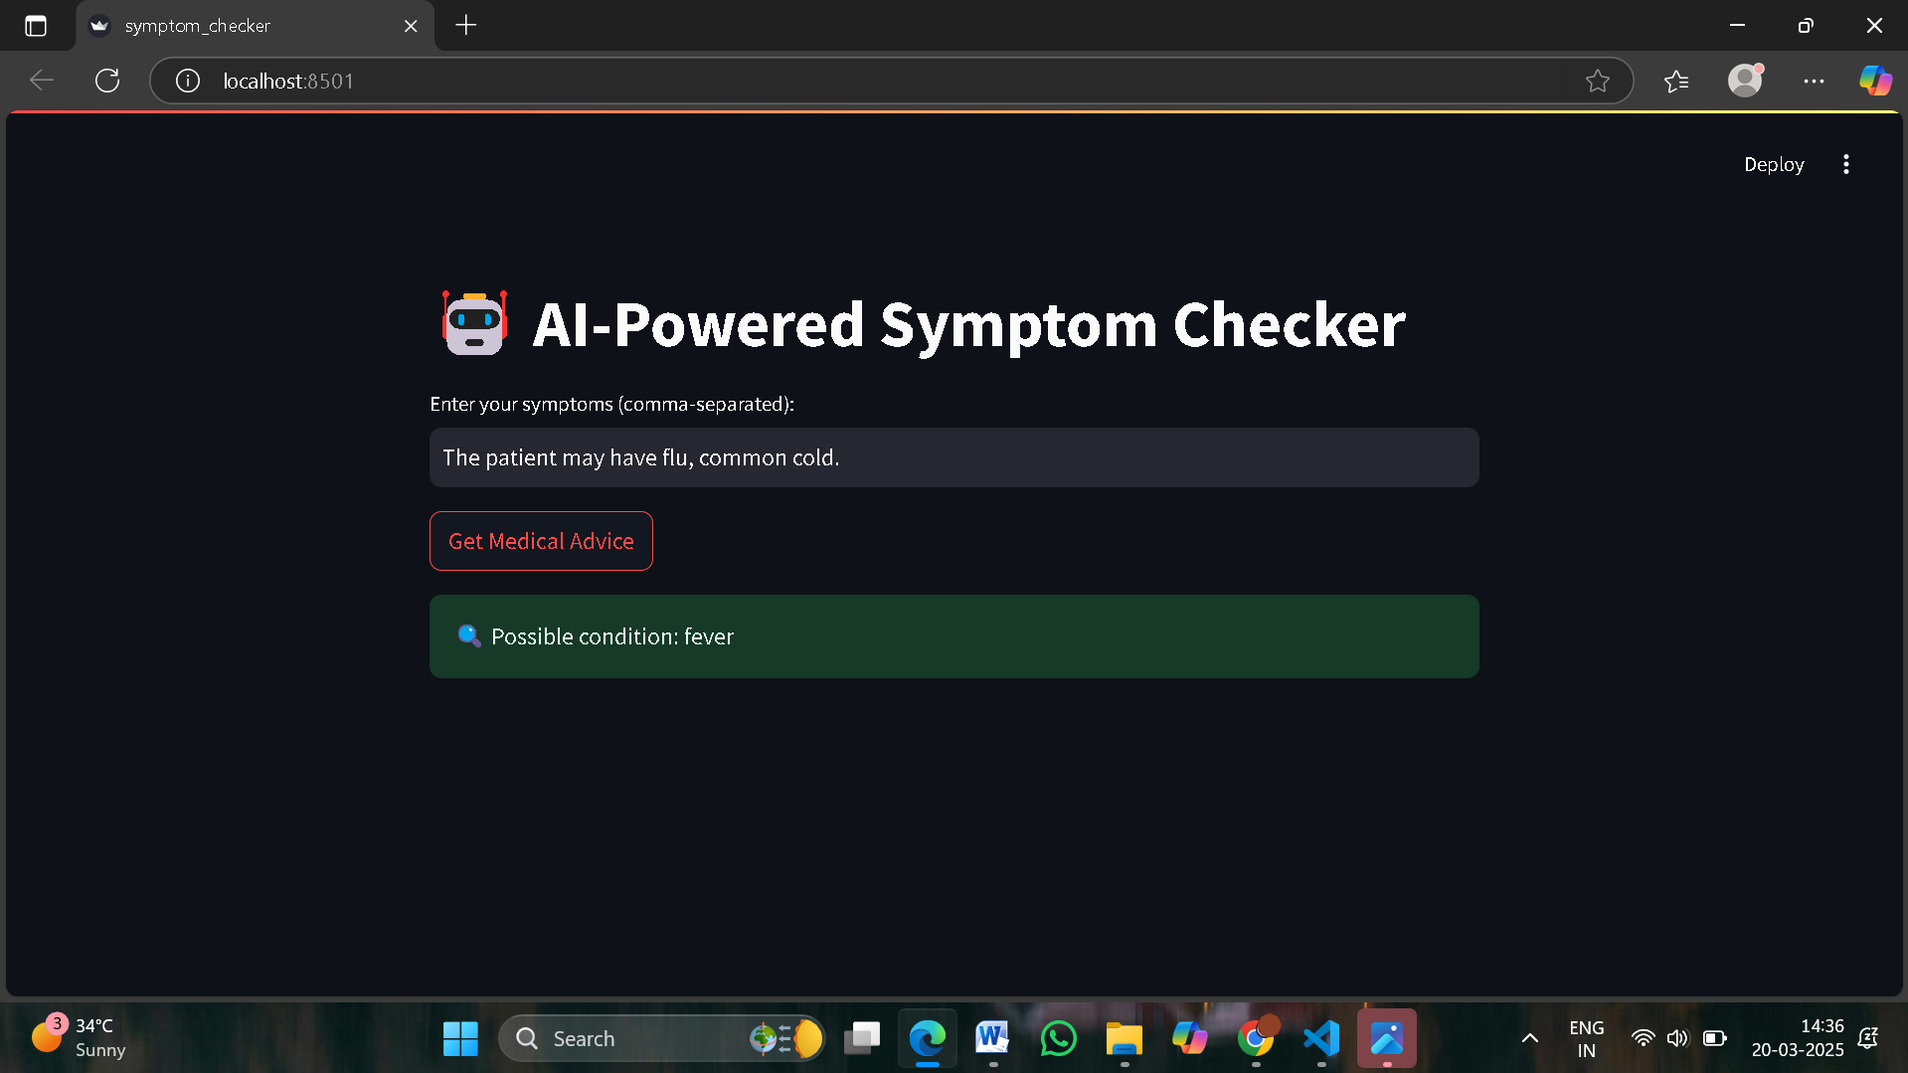
5.Snapshots
Fig: User enter the prompt of the sytmptom .
Fig: possible condition they have

Slide 9
6. Advantages, disadvantages
Advantages of Prompt Engineering in Healthcare
Enhanced Diagnosis: AI provides quick and accurate medical insights.
Improved Patient Interaction: Chatbots and virtual assistants offer instant responses.
Efficient Documentation: Automates report generation, reducing doctors’ workload.
Personalized Treatment: AI tailors medical advice based on patient data.

Slide 10
Disadvantages of AI in Healthcare
Data Privacy Concerns: Handling sensitive medical data requires strict security measures.
Dependence on Quality Prompts: Poorly designed prompts can lead to inaccurate results.
Limited Context Understanding: AI may struggle with complex medical cases requiring human judgment.
Ethical and Legal Issues: AI-generated advice must comply with healthcare regulations.

Slide 11
7.Applications
The AI-powered web application for Diabetic Retinopathy detection utilizes deep learning and a CNN-based model to provide accurate, real-time diagnosis with a user-friendly interface and remote accessibility. With secure data storage using MongoDB and scalable architecture, it enhances early detection, improves patient outcomes, and can be extended to detect other retinal diseases.
AI-Powered Symptom Checkers – Helps users identify possible health conditions based on symptoms.
Medical Chatbots & Virtual Assistants – Provides instant health advice and appointment scheduling.
Clinical Documentation Automation – Generates patient reports, prescriptions, and summaries.

Slide 12
Conclusion
Prompt engineering is revolutionizing healthcare by enhancing AI-driven medical support. While it offers significant benefits in diagnosis, treatment, and research, challenges like data quality, ethics, and AI bias must be addressed. With continued advancements, prompt engineering will play a crucial role in the future of AI-powered healthcare.

Slide 13
Thank you

